Slide 1
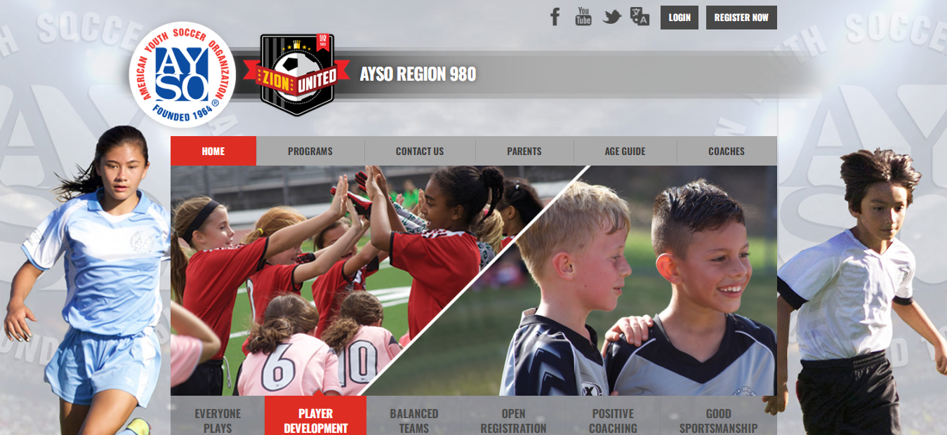

Slide 2
AYSO’s Vision and Mission
AYSO's Vision:
To provide world class youth soccer programs that enrich children’s lives.
AYSO's Mission:
To develop and deliver quality youth soccer programs which promote a fun, family environment based on AYSO's Six Philosophies:
Notes:
State the vision statement
Click for the Vision statement to appear
Click for the Mission statement to appear
Click for philosophies question to appear
CLICK for next slide that reviews philosophies.

Slide 3
AYSO’s Philosophies
Everyone Plays®.
Balanced Teams.
Open Registration.
Positive Coaching.
Good Sportsmanship.
Player Development.
Notes:
Click for philosophies to appear automatically.
Click to next slide for importance of philosophies.

Slide 4
AYSO’s Philosophies
Diversity, Equity and Inclusion
AYSO commits fully to its founders’ legacy of diversity, equity and inclusion. Providing fun and enriching soccer programs is what we do. We welcome everyone regardless of race, ethnicity, national origin, religion, gender, gender identity, sexual orientation, social-economic position, ability or disability. Differences are respected and embraced. AYSO is proud to be at the heart of communities where all feel that they belong.
Notes:
AYSO Policy 2.12 was recently revised to affirm AYSO’s commitment to Diversity, Equity and Inclusion.

Slide 5
AYSO Programs
Ages 3-18
Zion, Winthrop Harbor, Beach Park, Wadsworth,
Waukegan, Pleasant Prairie, Kenosha, Gurnee,
Antioch, Great Lakes, Park City, New Port
Notes:
AYSO Policy 2.12 was recently revised to affirm AYSO’s commitment to Diversity, Equity and Inclusion.

Slide 6
Changes Fall 2022 to Spring 2023
Fall 2022
8U (4 Teams)
10U (1 Team)
12U (1 Team)
14U (1 Team)
HS Girls (1 Team)
Spring 2023
Playground (Pilot Program Added - Ages 3 &4)
6U (Schoolyard Program)
8U (4 Teams)
8U Girls (1 Team)
10U (2 Teams)
12U (2 Teams)
14U (2 Teams)
HS Boys (1 Team)
Notes:
AYSO Policy 2.12 was recently revised to affirm AYSO’s commitment to Diversity, Equity and Inclusion.

Slide 7
Your Responsibility
Download BAND app
Communicate with Coaches
Practice attendance
Game attendance
Pictures (Rules about social media)
Kids Zone
Kids are #1!
Fun – not winning – is everything
Practice proper physical distancing
Set a proper example of sportsmanship
Players Play, Fans cheer and Coaches coach
Respect the volunteer referees…we couldn’t do it without them!
No yelling, swearing or abusive behavior
No weapons, alcohol, tobacco or drugs
Leave no trash behind
Celebrate the player – win or lose

Slide 8
Notes & Reference Items
Uniform delivery – ETA 4/6 or 4/7
Uniform Pickup – 4/13(David Park 5:30-6:30) 14U & HS given to coaches already
Coach Training – 4/8 (10U-14U)
Season Opens – 4/16
Poppin Popcorn Fundraiser – May 1st to June 5th (geared for 10U-HS for players participating in Section Tournament June 17th)
Zion United Gear – Online store set up with American Outfitters in Waukegan is open now until 4/28 (Goal to receive orders by 5/17) https://zionunited.itemorder.com/shop/home/
Shin guards required – all practices & games
Bring ball to practice
Size 3 Playground thru 8U
Size 4 10U & 12U
Size 5 14U thru Adult

Slide 9
Training Program Features
Coaches
AYSO’s coaching program features an innovative, age–appropriate curriculum, including in-person and online courses, interactive manuals, weekly training plans and online video demonstration content.
Referees
AYSO provides comprehensive training and an in-depth certification program to help volunteers become successful referees and stay engaged in your program to allow more kids the opportunity to play.
Administrators
AYSO provides management training to equip Administrators and Region Board Members with the skills to run a youth soccer program with in–person and online courses.
Notes:
State the vision statement
Click for the Vision statement to appear
Click for the Mission statement to appear
Click for philosophies question to appear
CLICK for next slide that reviews philosophies.

Slide 11
Zion United – AYSO980
Board Members
Regional Commissioner – Gail Reindl
Regional Coach Administrator – Rene Sixtos
Assistant Coach Administrator – Migual Barboza
Regional Referee Administrator – Mark Sekulich
Registrar – Lorena Olmos
Treasurer – Lise McCarthy
Safety Director – Eddie Olivera
Child & Volunteer Protection Advocate- Joni Goodman
Open Board Members
Assistant Regional Commissioner
Assistant Registrar
Assistant Treasurer
Open Volunteer Positions
Uniform Coordinator
Trophies Coordinator
Picture Day Coordinator
Field & Equipment Coordinator
Scheduler
Website/Social Media
Notes:
AYSO Policy 2.12 was recently revised to affirm AYSO’s commitment to Diversity, Equity and Inclusion.

Slide 12
Fall Registration – Opens May 15 – Aug 5
AYSO980.org (Register & Pay online)
Ages 3-18 (Playground – High School)
Fall Fee $80.00 & Spring Fee $80.00
(Early Bird $60.00 5/15- 7/5)
National Player Fee $25.00
Uniform Fee* $50.00
*new players only or if player needs a new one
www.ayso980.org

Slide 14
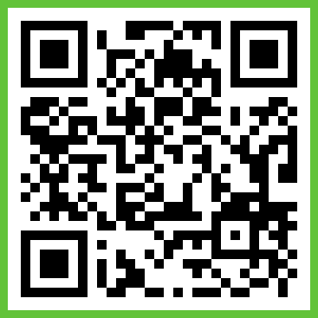
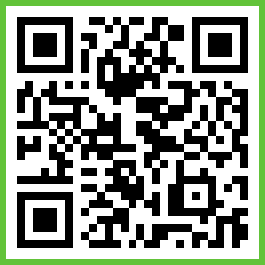
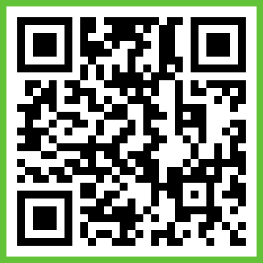
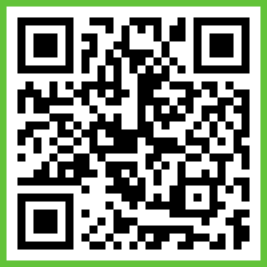
Playground
Schoolyard (6U)
8U Girls
10U – Coach Miguel
10U – Coach Thalia & Coach Heidi
www.ayso980.org
12U – Coach John

Slide 15
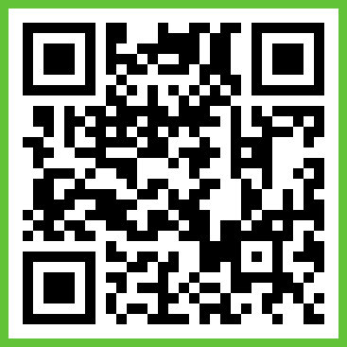
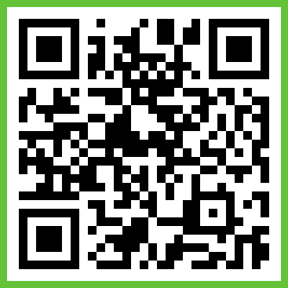
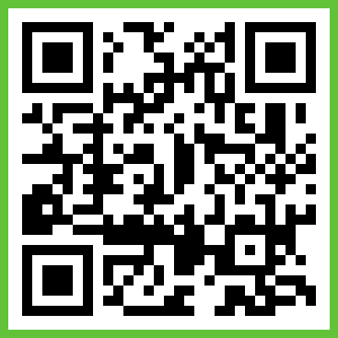
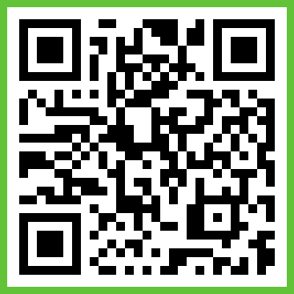
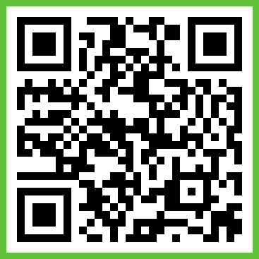
8U – Coach Albert
8U – Coach Eddie
8U – Coach Miguel
8U – Coach Rudy
8U – Coach Rio
HS Boys – Coach Rene & Coach Mark

